Slide 1
Fortran 90/95/2003 Notes
- Johnny Jaffee

Slide 2
Note – I have no Fortran experience and I made these notes to get a little more familiar with it, so as a result there may be some errors/misconceptions.

Slide 3
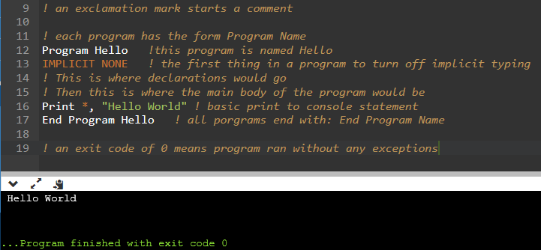
Structure of a Basic Program
General Form:
Program Name
Implicit none
All declarations
Body of program
End Program Name
Implicit Typing:
Legacy feature from Fortran 77
Means variables do not need to be declared.
If variable is not declared, the first letter in its name determines it’s type.
I, j, k, l, m, or n is assumed an integer, anything else is assumed real
This is very confusing, so by using IMPLICIT NONE at the top of a program implicit typing is turned off
General Notes:
! Starts a comment
Case does not matter
Print*, displays data to console
Exit code of 0 means program ran without exceptions

Slide 4
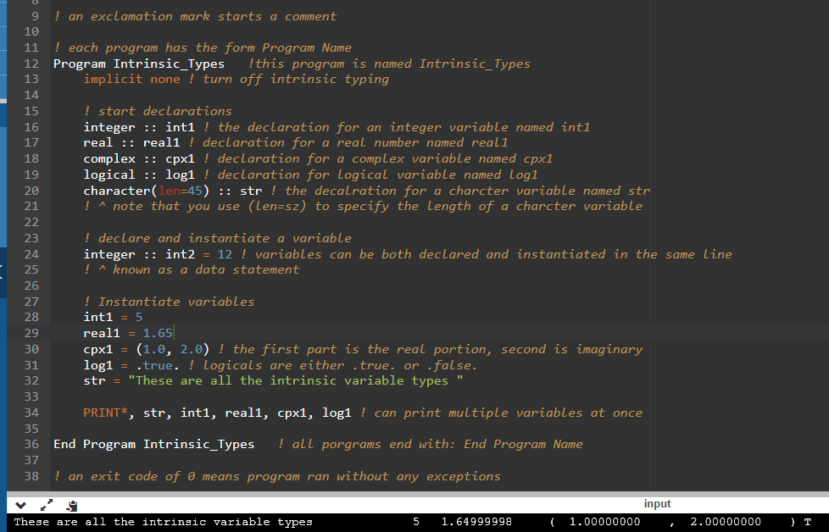
Intrinsic Variables
Intrinsic Variables:
Include integer, real, complex, logical, and character
Can be declared and initialized in the same line, this is known at a data statement
Note that the :: operator is used for declaration
General form: type :: name
Use (len=size) to specify number of characters in a character variable. Do not need if it is a single character (char)
Once more, not case sensitive
Names (identifiers) cannot be longer than 31 characters, are alphanumeric, can have underscores, and are case insensitive
Can be more but goes against LM programming standards. Also compiler dependent maybe?
ALL DECLARATIONS NEED TO BE MADE PRIOR TO INTIALIZING ANY VARIABLES

Slide 5
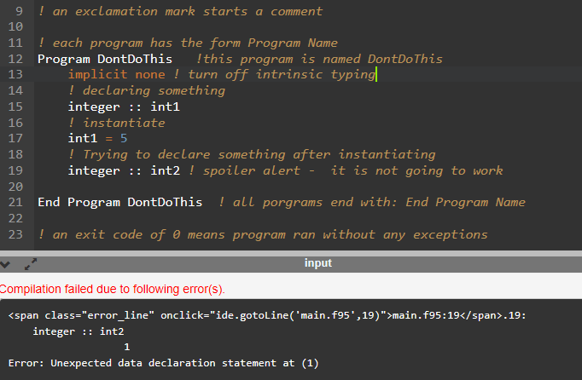
ALL DECLARATIONS NEED TO BE MADE PRIOR TO INTIALIZING ANY VARIABLES
Cannot declare any new variables after a variable has been initialized
NOTE: this does not apply for a data statement. ie, you can have a statement like –
integer :: int1 = 10
- and still declare new variables below that line

Slide 6
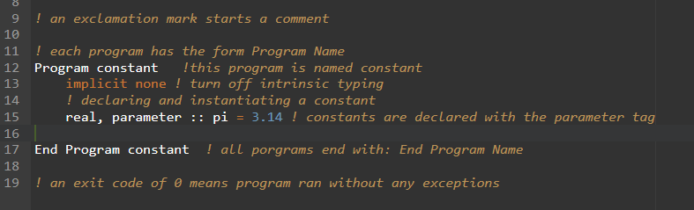
Constants
Just add the parameter tag
Should be at the beginning of the program
Cannot change the value of a constant

Slide 7
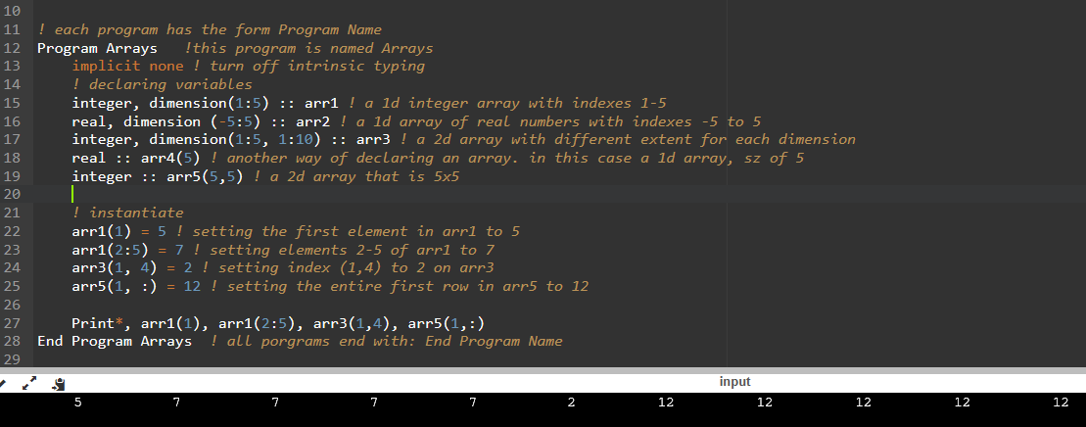
Arrays
Definitions:
Rank: Number of dimensions of the array
Extents: Number of elements along a dimension
Shape: a vector (1d array) of integers containing the rank of each dimension in the array
Size: total number of elements in the array
Notes
Arrays can be up to 7d
: in an array index means the entire dimension
: operator increments between the two numbers by 1
Can increment by other than one via:
(index1:increment:index2)
Indexing is done via () (above examples)

Slide 8
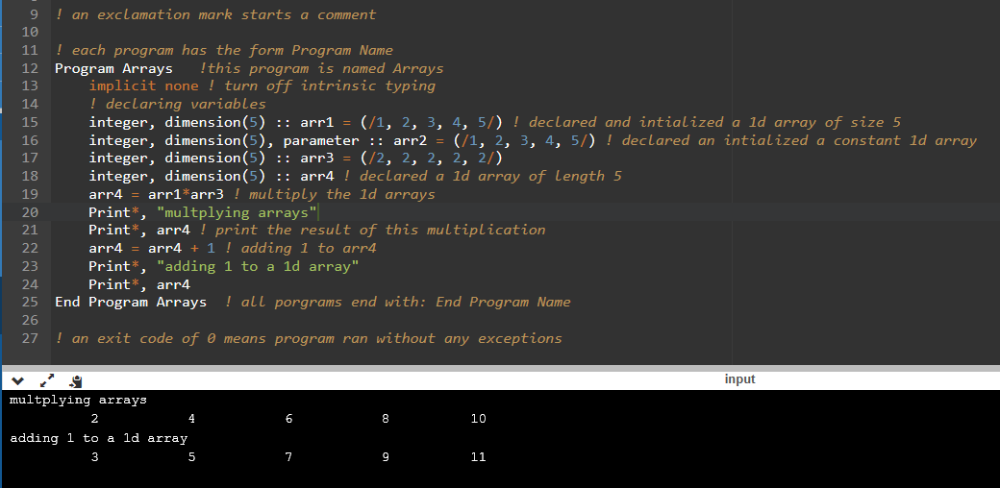
Arrays Continued
Definitions:
Rank: Number of dimensions of the array
Extents: Number of elements along a dimension
Shape: a vector (1d array) of integers containing the rank of each dimension in the array
Size: total number of elements in the array
Notes
For 1d arrays, can use the following array constructor:
(/ele1, ele2, ele3, ect/) to initialize an array
Arithmetic operators apply to arrays
Does element by element, does NOT produce matrix product
^ arrays need to be same shape

Slide 9
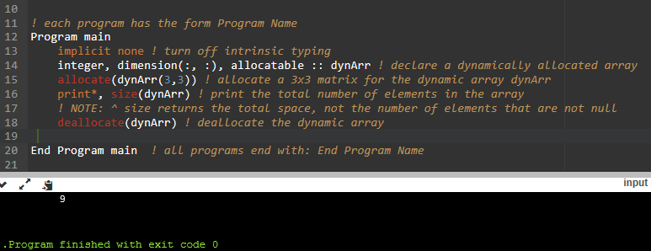
Dynamic Arrays
To declare:
Type, dimension(:, :), allocatable :: name
The number of :, : specifies the rank
: means the extent of that dimension is not known
To allocate:
Allocate(name(dim1, dim2))
Dim1, dim2, etc. specify the extent of each dimension. The number of extents you need to specify is the rank of the array
Need to allocate before use
To deallocate
Deallocate(name)
Notes
Use size(arrayName, dim) to return the number of elements at the specified dimension (extent at that dimension) for the array myArray
The dim argument is optional. Without it it just returns the total size of the array
Returns total space, not the total number of non-null elements

Slide 10
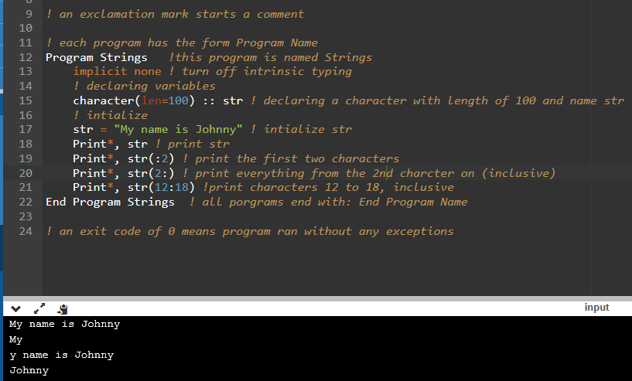
Character String
Notes
Similar indexing to arrays
Can use (:4) to get first 4 characters
Use (4:) to get characters from 4 onwards (inclusive)
Use (index1:index2) to pick a specific substring

Slide 11
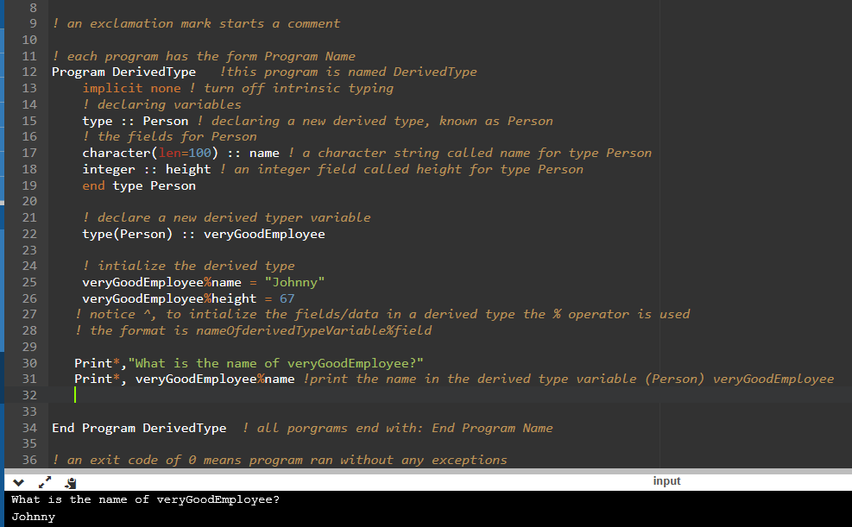
Derived Data Types
General Form:
Type :: name
some intrinsic variable declarations
End Type name
Groups together data into a common data type
Can make arrays of structs: type(Person), dimension(5) :: array
Notes
Essentially the same thing as a struct in MATLAB or C/C++
Fields are accessed via the % operator
derivedTypeVariable%field is how it is accessed

Slide 12
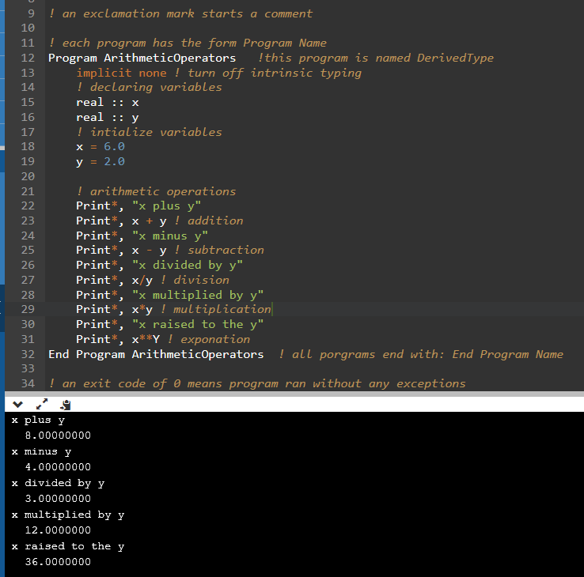
Arithmetic Operators
Notes
Pretty self explanatory
Be mindful of type and precision. Very small numbers my be subject to round off errors
Can use real(2) to express a number as a real number

Slide 13
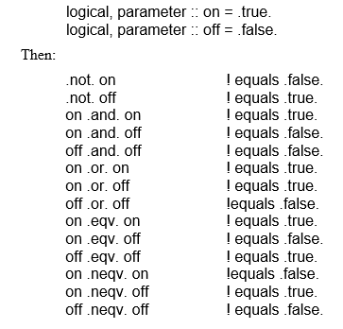
Logical Operators
List:
.not.
.and.
.or.
.eqv.
.neqv.
Fortran 90/95 Programming Manual, Tanja van Mourik (2005)

Slide 14
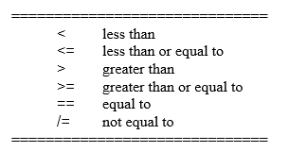
Relational Operators
Note that when comparing real numbers, precision is limited, so it is often better to compare to a tolerance. Example:
Instead of (a == 6), use (a – 6) <= abs(0.001) since a may be stored as 6.000001
Fortran 90/95 Programming Manual, Tanja van Mourik (2005)

Slide 15
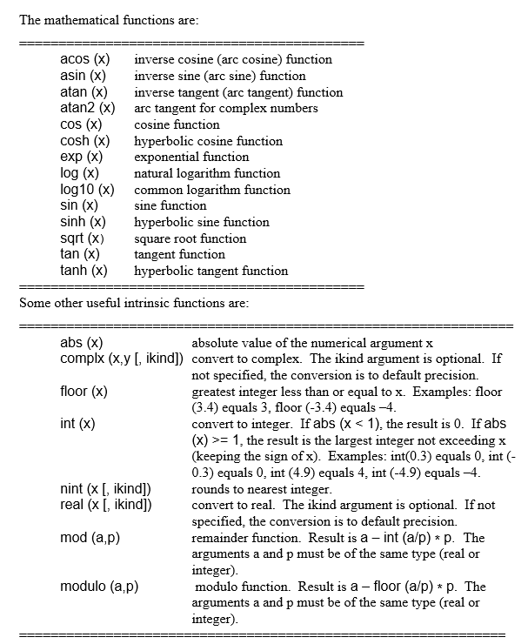
Intrinsic Functions
Fortran 90/95 Programming Manual, Tanja van Mourik (2005)

Slide 16
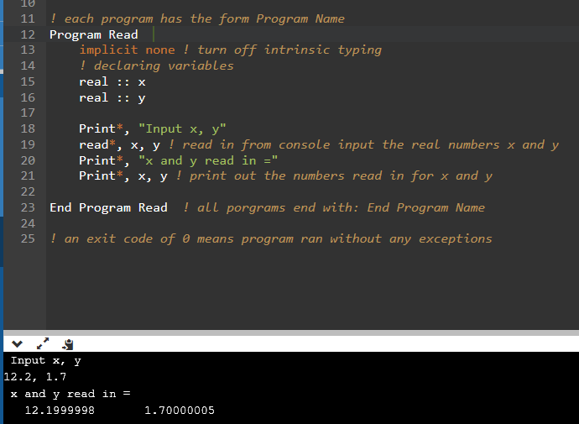
Simple Input/Output
Notes
Use Print*, for output to console
Read*, vars for input form console
Notice that precision results in imperfect representation as a real number. Keep this in mind when using relational operators
Misc: max length a line can be is 132 characters. Use & to continue line onto the next line

Slide 17
Control Construct
If statement syntax:
If (condition) then
Body of if statement
End if
If Else:
If (condition) then
body of if
Else
body of else
End if
*can nest
Do loop syntax:
Do some form of counter
body of do loop
End do
Endless Do Loop
Do
if (condition) then
exit
end if
body of do loop
End do
If statement nested in do loop with exit command used to break do loop
NOTE: no () after do
Case:
Select case (expression)
case (selector)
line(s) to execute
case (selector)
line(s) to execute
case default
executes if did not match any other
End select
Can have mores cases

Slide 18
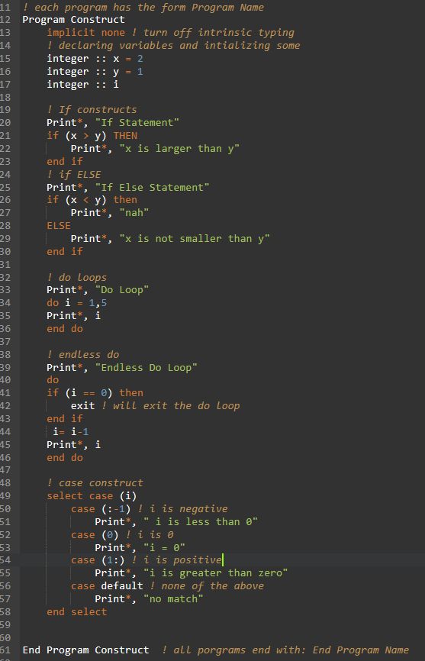
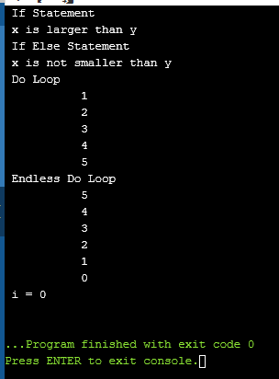
Control Construct Example

Slide 19
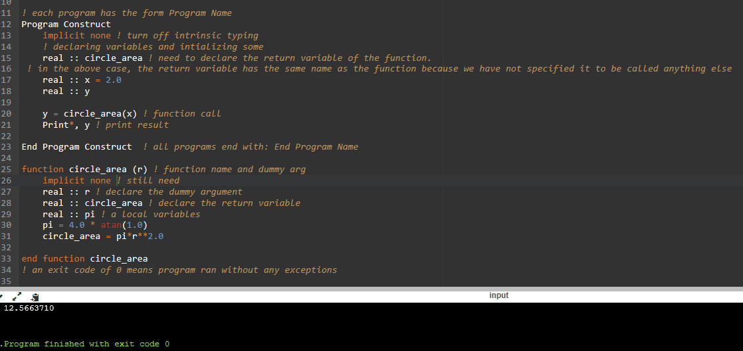
Function
General Form:
Function name(dummy argument) result(return)
implicit none
declare return type
declare dummy argument
function body
End function name
The result(return) is optional, and only used if you want the function return value to have a different name than the function’s name. If you do use this option, the argument return must be the name of an initialized variable in the function body
Call via: x = myfunction(arg)
Notes
Returns a single value, and does not modify arguments. Unless specified, the returned value has the name of the function
Dummy argument is replaced by the argument passed into the function
NEED TO DECLARE THE RETURN OF THE FUNCTION IN MAIN PROGRAM

Slide 20
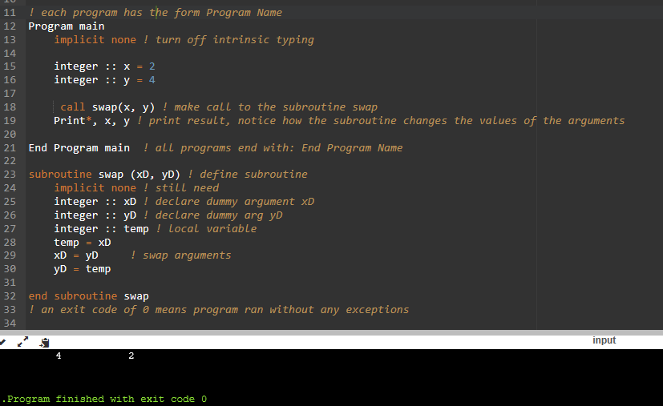
Subroutines
General Form:
subroutine name(dummy argument)
implicit none
declare dummy argument
body
End subroutine name
Call via: call mySubroutine(arg)
Notes
CHANGES THE VALUE OF THE ARGUMENTS

Slide 21
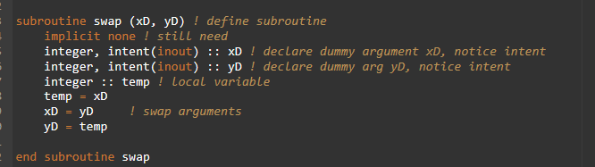
Intent
Notes
Can specify the intention in which arguments are used in procedures (functions/subroutines)
Use: intent(val) as a parameter in the dummy argument declaration in the procedure
Options include: in (used but not changed), out(arguments overwritten), inout (used and overwritten)
Syntax: type, intent(in) :: var
Compiler throws warnings or fails usually if violated

Slide 22
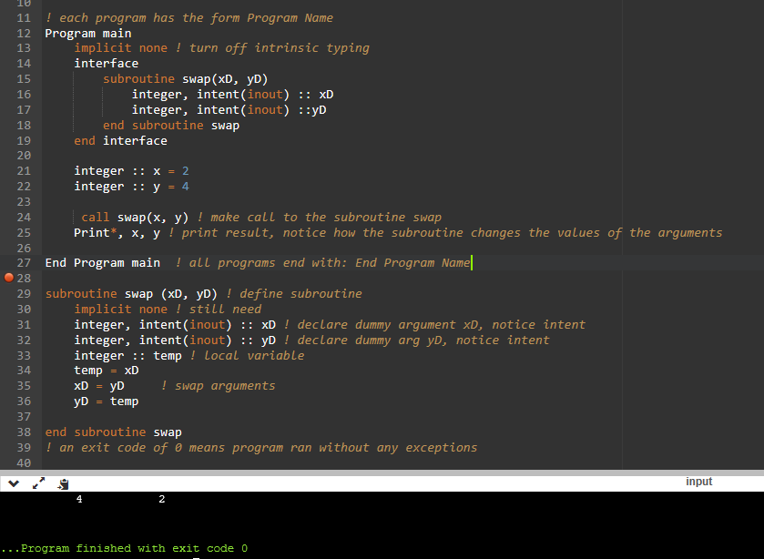
Interfaces
General Form:
interface
subroutine name(dummy args)
declare dummy argument, w/ or w/o intent
end subroutine name
End interface
Basically the same thing as a method stub
Notes
Good practice for external (not in main program) subroutines
Placed at beginning of program or procedure that is using another procedure

Slide 23
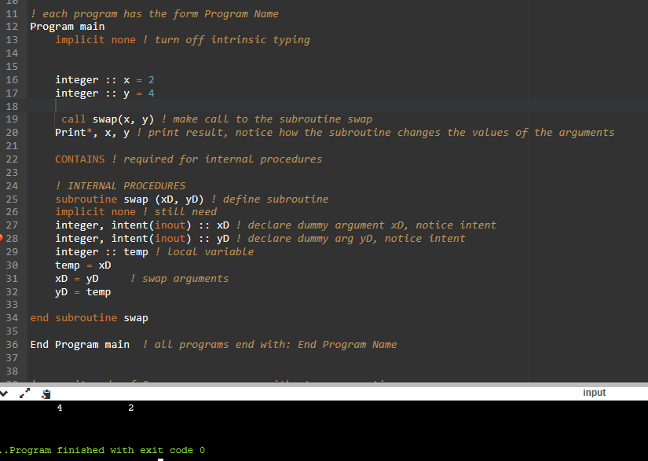
Internal Procedures
General Form:
Program name
implicit none
declarations
body and executable statements
Contains
internal procedures
End program name
Notes
The subroutine or function is found within the program block
Only visible to that program block
UNLIKE EXTERNAL FUNCTIONS, THE FUNCTION RETURN IS NOT SPECFIED IN THE MAIN PROGRAM BECAUSE IT IS ALREADY CONTAINED WITHIN IT

Slide 24
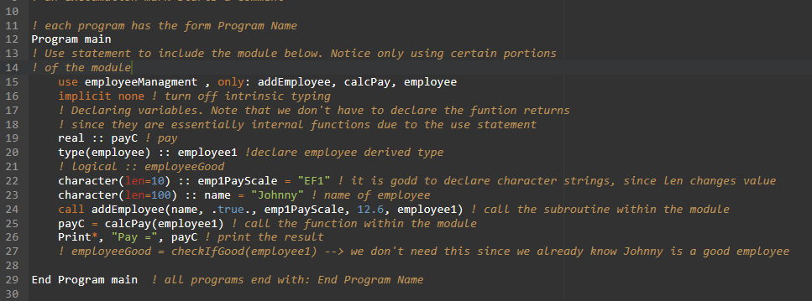
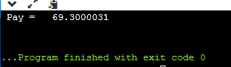
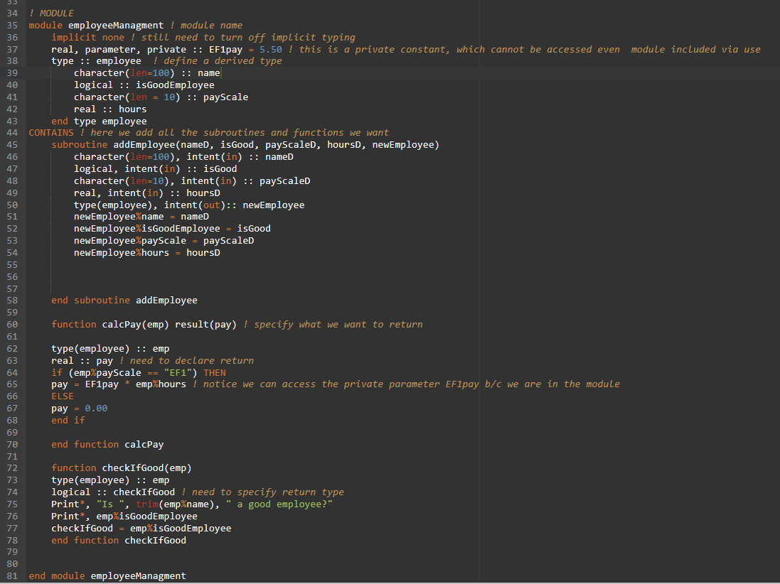
Modules
General Form:
Module name
implicit none
declarations/interfaces/specifications
Contains
internal procedures
End module name
Notes
Basically a class in C/C++ or java
Can allow for behavior similar to object oriented program, where the module acts similar to an object. Also can be used for data encapsulation.
Data in the module can be set to public or private, see example above
Public allows for visibility from program module is included in
To include module: use moduleName (like including a header in C++)
Use statement needs to be first statement in program, before implicit none
Can use the only option to specify which elements in the module are to be used, see example above
NOTICE – do not specify return of function in main program. This is because the use statement that includes the module means that the function is essentially internal

Slide 25
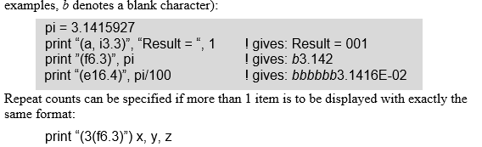
More on I/O
Fortran 90/95 Programming Manual, Tanja van Mourik (2005)
Notes
Can add format specification to read and print:
Read “(fmt)”, variables_list
Print “(fmt)”, variable_list
fmt is for the form specifiers
Fmt Specifier exampls:
aw = a denotes a character variable, for w you put an integer to specify width
fw.d = f denotes reals, w is an integer for the width, d is the number of decimals to display
esw.d = es means display real in scientific notation. W is still width and d is number od decimals
Iw.m = I denotes integer, w is the width, and m is the minimum number of digits to be displayed
You can bunch multiple formatters in () when printing multiple variables. They correspond to the variable in the list with the same position
To display the same format for multiple variables, can use Print “(#(fmt))”
# ^ is the number of variables in the list to apply the fmt spec to

Slide 26
More on I/O: Files
Notes
Opening a file:
Open(unit = u, file = filename, status = st, action = act)
U is a positive integer, generally between 1-99. 0, 5, and 6 often reserved for console and other internal stuff
Filename is the name of the file as a character expression
St is a character expression. “new” = new file that does not exist yet but will be created by open statement, “old” = file exists, “replace” = if the file exists it is deleted and replaced, otherwise it is created, “scratch” = the file is used just during execution and then deleted
Act is a character expression. “read” = file can be read, “write” = file can be written to, “readwrite” = both
* can add the parameter iostat = ios which returns an integer. Returns 0 is opened correctly. Remember to declare variables
Reading a File:
Read(unit = u, fmt = “(fmt)”) variable_list
U and fmt are the same. Variable_list is what variables are having data assigned to them
Writing to a file:
Write(unit = u, fmt = “(fmt)”) variable_list
Same, variable_list is variables to write to file
Closing a file:
Close(unit = u, status = st)
St can be “keep” = keep after closing, or “delete” = deletes after closing
Can also use iostat like with the open statement
Don’t need the status argument, it’ll default to keep
* is wildcard for formatter I think, basically lets it interpret on its own

Slide 27
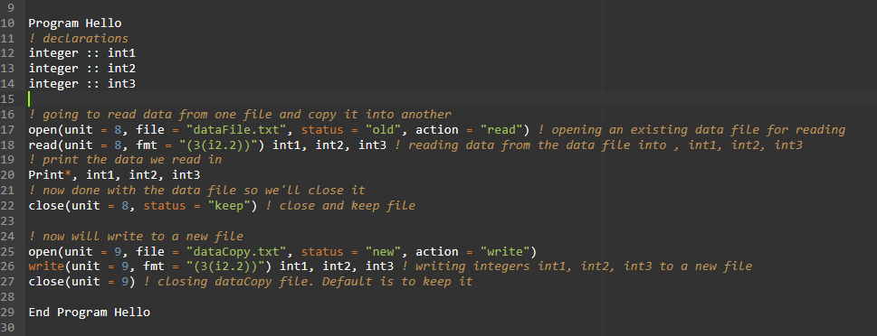
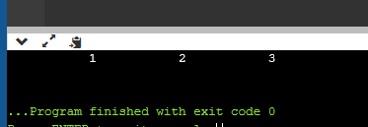
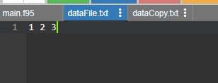
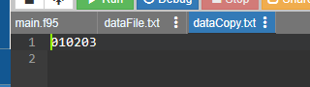
More on I/O: File Example

Slide 28
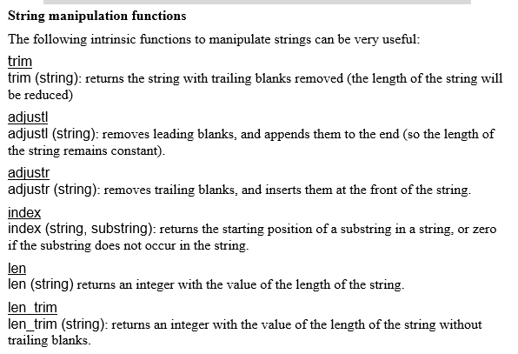
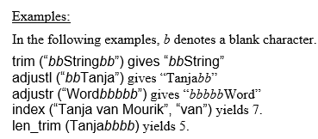
Intrinsic String Manipulation Functions
Fortran 90/95 Programming Manual, Tanja van Mourik (2005)

Slide 29
Pointers
Notes
Unlike C/C++, a pointer in Fortran holds more than just the memory address:
Memory address
Information about target: type, value, rank (is applicable), extents (if applicable)
To declare add the pointer parameter:
Type, pointer :: name Example → integer, pointer :: ptr
For pointers to arrays, the array must be deferred shape, meaning only the rank is specified. Extents just have an :
Example → integer, pointer, dimension(:, :) :: arrayPtr (pointer to 2d array)
Assigning a target to a pointer:
Using a target variable:
Declare a target variable via target parameter → type, target :: targetName
Use the => operator to set the target variable as the target of the pointer → pointer => target
Assigning pointer = new_value will change the value of the target
No allocation required since it is done in the initial declaration of the target variable
Do not deallocate
Pointer acts as an alias to the target variable
=> can only be used on target variables
Without a target variable
Will need to first allocate memory for the data to be stored by the pointer → allocate(ptr)
Then use = → ptr = non_target value or variable
^ this effectively enables a variable of specified type to be dynamically allocated
Can use deallocate(ptr) to deallocate reserved memory
To disassociate a pointer from it’s target (won’t point to it anymore), can use nullify(ptr). Deallocation also implies nullification
You can check if a pointer has a target:
Associated(ptr) → returns true if pointer has a target
Associated(ptr, target) returns true if target is ptr’s target (ptr being a specific pointer variable)
Pointers can have the same target

Slide 30
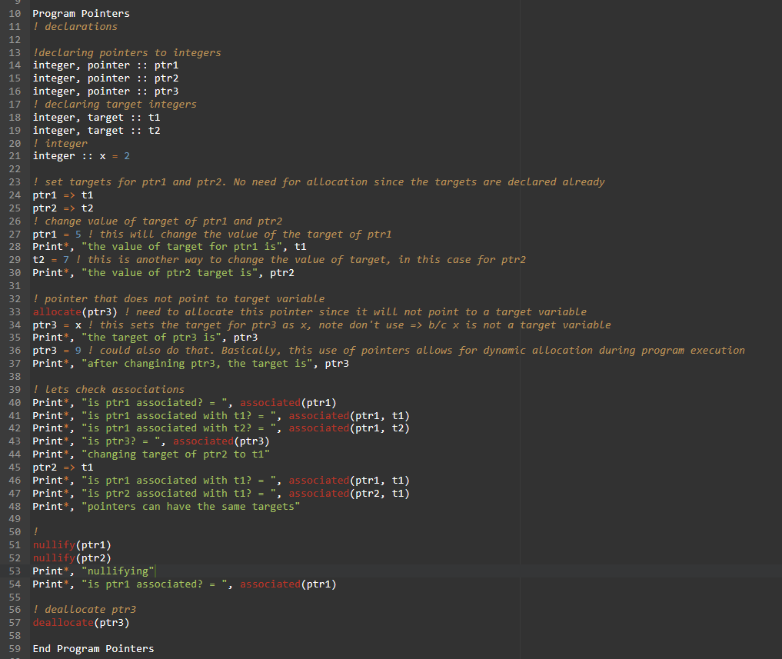
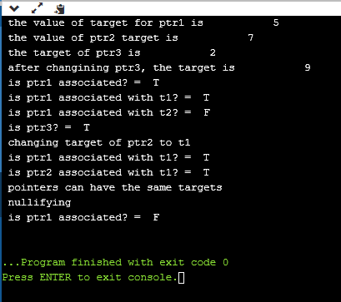
Pointer Example

Slide 31
Numeric Precision
Notes
Can select precision:
For real numbers:
Real(kind = #) :: name → get kind number via: # = selected_real_kind( p = #, r = #)
P is the number of decimals, r is the range -10^r to 10^r
For integers:
integers(kind = #) :: name → get kind # via: selected_int_kind(r = #)
R is the same as it is for real numbers
Example:
Ikind = selected_real_kind(3, 7)
Real(kind = ikind) :: var1
^ var1 has 3 decimal places and is between 10^-7 to 10^7

Slide 32
Scope and Lifetime
Notes
For local variables in subroutines:
Lifetime is as long as the subroutine, or routine called by it, is running
Can add save as a parameter in the variable declaration to keep it’s value between calls
Example → integer, save = name
Initializing a variable in it’s declaration (data statement) gives it the save status
Scope is only within the subroutine (same deal for a function)
Variables in modules:
Lifetime is as long as any routine using the module is running
Scope extends to any routine using the module. When the routine ends so does lifetime.

Slide 33
Fortran 2003 Object Oriented Programming (OOP)

Slide 34
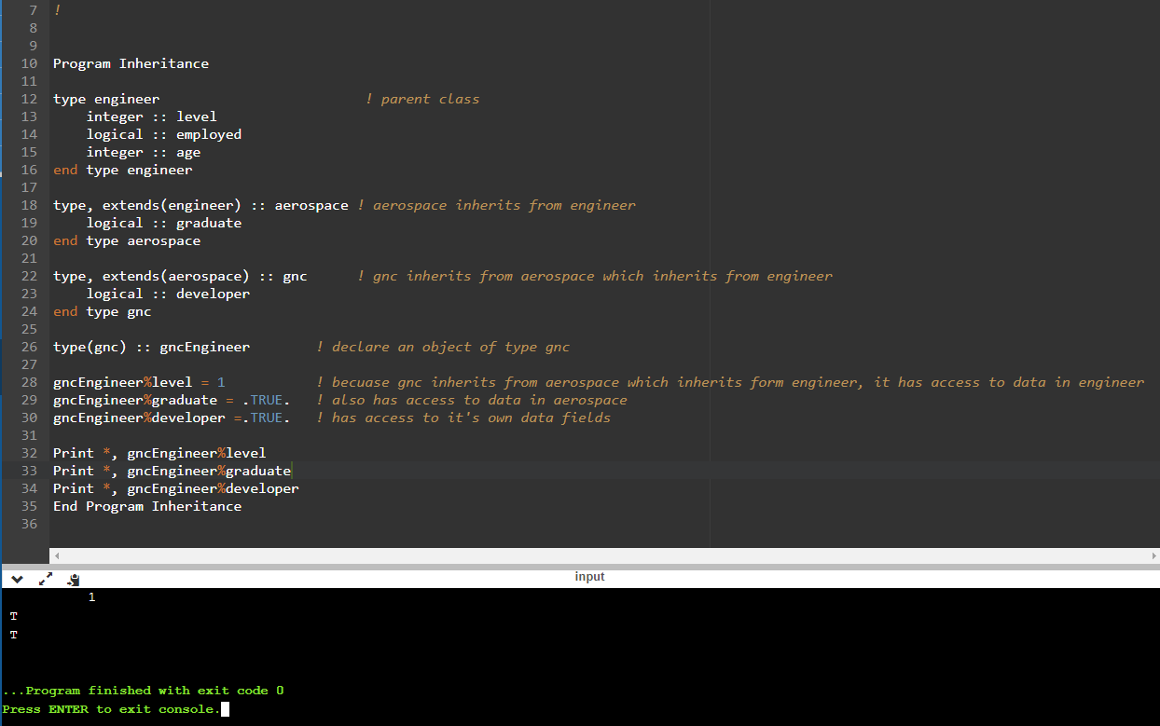
Objects
Fortran 90/95:
A module is the closest item to a module because it encapsulates both data and procedures
Fortran 2003:
Fortran 2003 implemented the ability to encapsulate procedures, and not just data, into derived types, allowing for derived types to also be considered objects.
Introduced type extension to derived types, meaning, that derived types inherit data fields from it’s parent object.
The EXTENDS keyword followed by the name of the parent object in () is used to declare an inherited object.

Slide 35
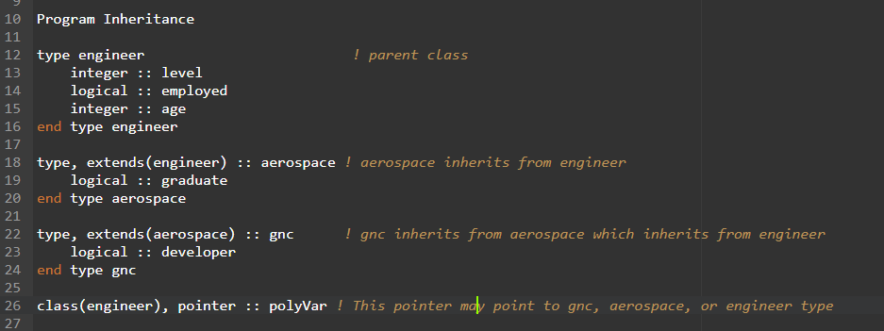
Data Polymorphism Fortran 2003
Fortran 2003 introduces the CLASS keyword which enables developers to create polymorphic variables
A polymorphic variable is a variable whose type is dynamic at run time
A polymorphic variable must be a pointer variable, allocatable variable, or dummy argument
When a polymorphic variable is instantiated, the type is determined.

Slide 36
Data Polymorphism Fortran 2003
Fortran 2003 supports an “unlimited” polymorphic object
An unlimited polymorphic object is an object that can operate on any type, whether derived or intrinsic
An unlimited polymorphic object is declared with class(*) keyword
Still must be a dummy variable, pointer, or allocatable variable

Slide 37
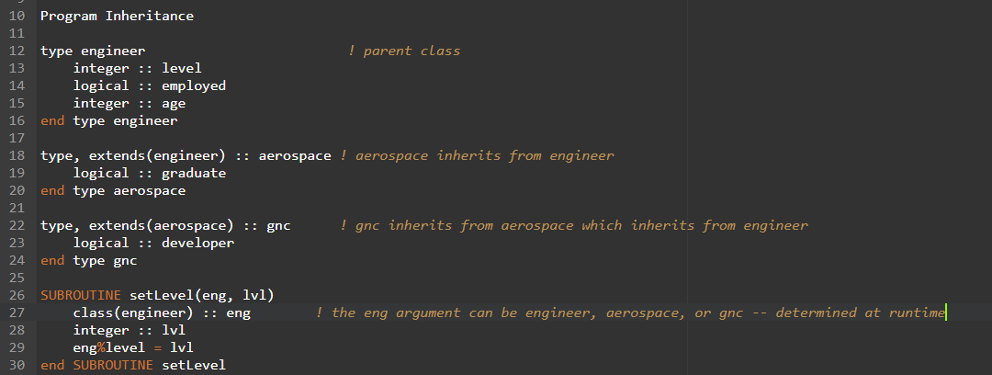
Procedure Polymorphism Fortran 2003
Procedure polymorphism is when a function or subroutine can use a variety of data types as arguments
This is accomplished when the dummy arguments are declared with the CLASS keyword
NOTE → the only components available are those in the type declared, so in the example below on line 27 eng can only access the level, employed, and age fields since it is declared as type engineer

Slide 38
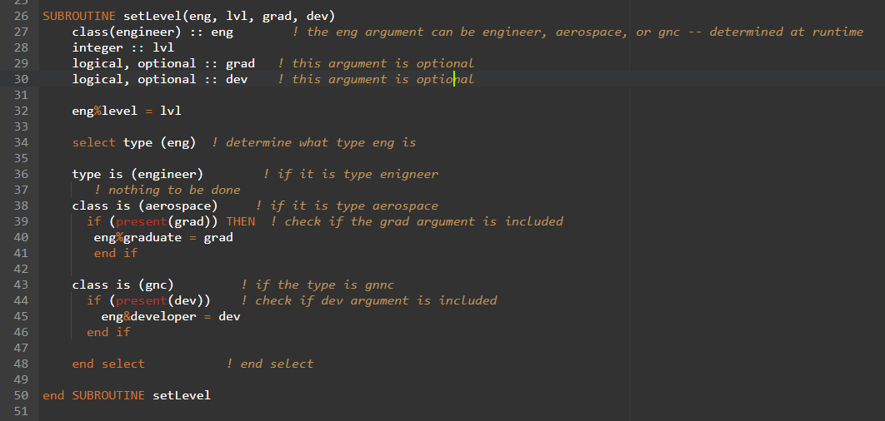
Procedure Polymorphism Fortran 2003
Fortran 2003 offers the ability to check the type of a polymorphic variable using SELECT TYPE
Use of SELECT TYPE allows for access of inherited components that may differ from the declared parent type
Optional arguments can be used as well to account for the possible different argument types
The type is used for when the object is not declared using the class keyword

Slide 39
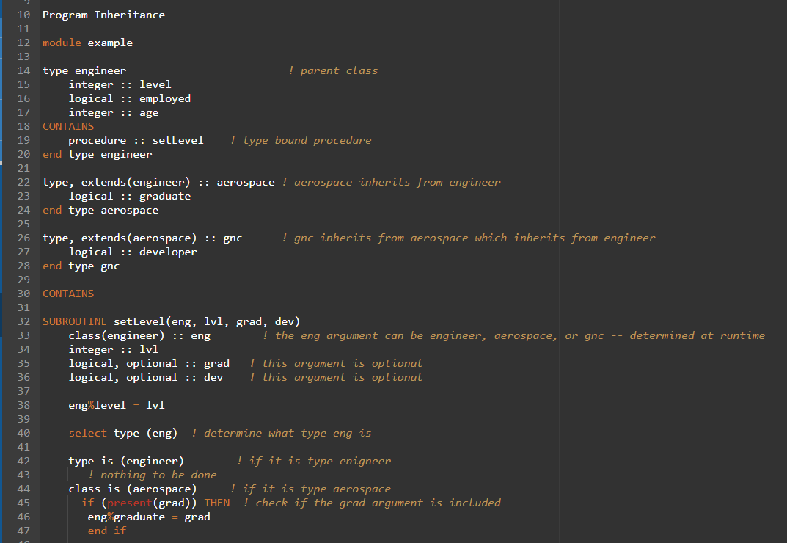
Type Bound Procedure Polymorphism
Using the contains keyword, derived types can encapsulate procedures.
These procedures may be module procedures or external procedures with an explicit interface
To call that procedure → object%procedure(args)
Need to include the module where the procedure is called with a use statement
Derived types, such as aerospace and gnc below, also inherit procedures. Hence they have access to the initialize procedure contained in the engineer type. The procedure is called the same way as it is called in the parent object.

Slide 40
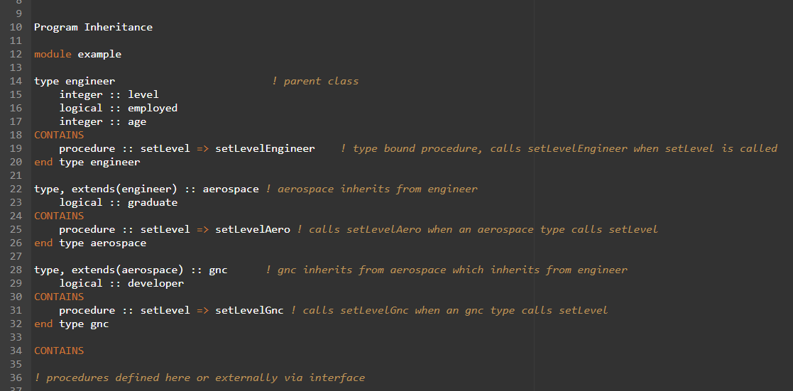
Procedure Overriding
For derived objects, procedures contained in the parent object can be overridden
This is done by having the procedure call be a pointer to another procedure
Can also still call parent procedure via → gncObject%aeroObject:engineerObject%setLevel(Args…)

Slide 41
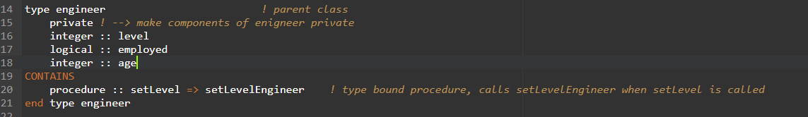
Visibility
Public and Private keywords determine visibility of objects and procedures
Private is only visible to the host module
Using private visibility allows for information hiding.
Often this is used to make data fields private and a public constructor is used to initialize those fields

Slide 42
Notable differences relative to C++
Implicit typing by default, need to turn off (slide 2)
Need to declare ALL variables before assignment/initializing new variables. Can’t declare a new variable after any assignment statements. (slide 4)
Can use arithmetic operators on entire arrays to get element by element results (slide 7)
Subroutines will change the arguments in the main program, without having to use a reference like in C++ (slide 19)
Pointers are more like aliases. No address-of operator or dereferencing operator. Printing the value of a pointer will give the value of the target. An assignment statement on a pointer (pointer = value) will change the value of the target. Target variables need to be declared as such. Pointers in Fortran as far as I can tell are also used to enable dynamic allocation of variables of varying type (I could be wrong about this though). (slide 28-29)
Not object oriented until Fortran 2003. Although modules in Fortran 90/95 can add some object oriented concepts like data encapsulation. No inheritance though.

Slide 43
Helpful gdb commands for debugging
break – set a break point
run – begin execution of program
cont – continue execution
next – execute the next line only, without stepping into any function/subroutine
step – execute next line and step into any function/subroutine

